Slide 1

Starting out with Visual Basic®
Seventh Edition
Chapter 7
Multiple Forms, Modules, and Menus
Copyright © 2017, 2014, 2011 Pearson Education, Inc. All Rights Reserved
Notes:
If this PowerPoint presentation contains mathematical equations, you may need to check that your computer has the following installed:
1) MathType Plugin
2) Math Player (free versions available)
3) NVDA Reader (free versions available)

Slide 2
Learning Objectives
7.1 Multiple Forms
7.2 Modules
7.3 Menus
7.4 Focus on Problem Solving: Building the High Adventure Travel Agency Price Quote Application

Slide 3
Overview (1 of 2)
This chapter demonstrates how to:
Add multiple forms to a project
Create a module to hold procedures and functions
Create a menu system with commands and submenus
Create context menus that appear when the user right-clicks on an item

Slide 4
7.1 Multiple Forms

Slide 5
Windows Forms Applications (1 of 2)
Windows Forms applications are not limited to only a single form
You may create multiple forms
To use as dialog boxes
Display error messages
And so on

Slide 6
Windows Forms Applications (2 of 2)
Windows Forms applications typically have one form called the startup form
Automatically displayed when the application starts
Assigned to the first form by default
Can be assigned to any form in the project

Slide 7
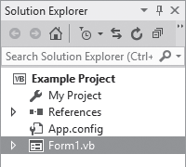
Form Files and Form Names
Each form has a Name property
Set to Form1 by default
Each form also has a file name
Stores the code associated with the form
Viewed in the Code window
Has the same name as the form
Followed by the .v b extension
Shown in the Solution Explorer window

Slide 8
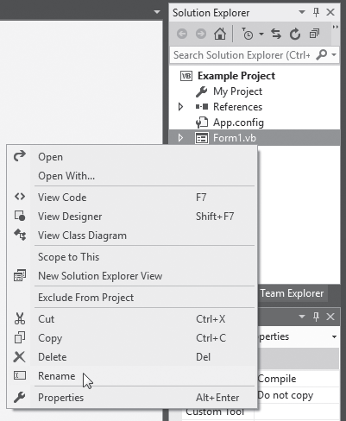
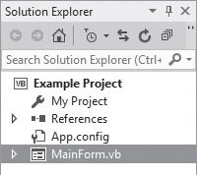
Renaming an Existing Form File
Always use the Solution Explorer window to change the file name and the form’s Name property will change automatically
To rename a form file:
Right-click file name in Solution Explorer
Select Rename from the menu
Type the new name for the form
Be sure to keep the .v b extension

Slide 9
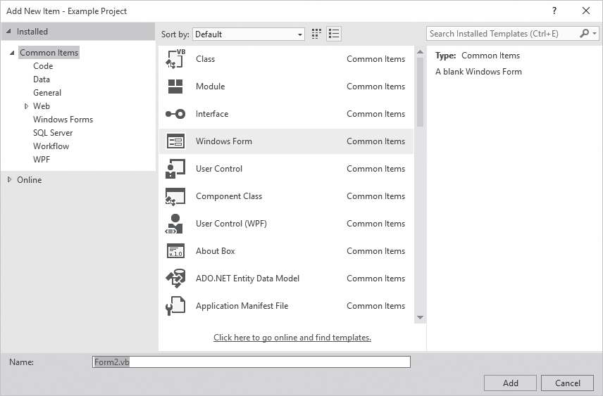
Adding a New Form to a Project
To add a new form to a project:
Click Project on the Visual Studio menu bar, and then select Add Windows Form . . . The Add New Item window appears
Enter the new Name in the Name text box
Click the Add button
A new blank form is added to your project

Slide 10
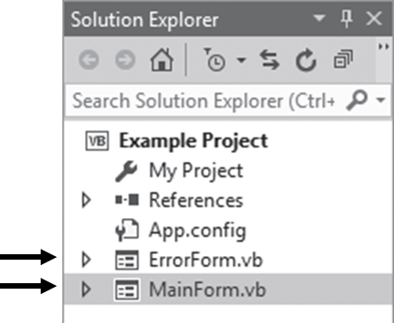
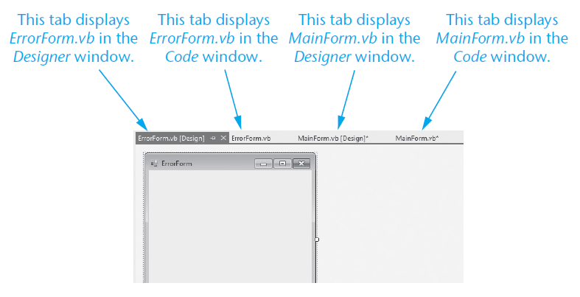
Switching between Forms and Form Code
To switch to another form:
Double-click the form’s entry in the Solution Explorer window
To switch between forms or code:
Use the tabs along the top of the Designer window

Slide 11
Removing a Form
To remove a form from a project and delete its file from the disk:
Right-click the form’s entry in the Solution Explorer window
On the pop-up menu, click Delete
To remove a form from a project but leave its file on disk:
Right-click the form’s entry in the Solution Explorer window
On the pop-up menu, click Exclude From Project
Or
Select the form’s entry in the Solution Explorer window
Click Project on the menu, and click Exclude From Project

Slide 12
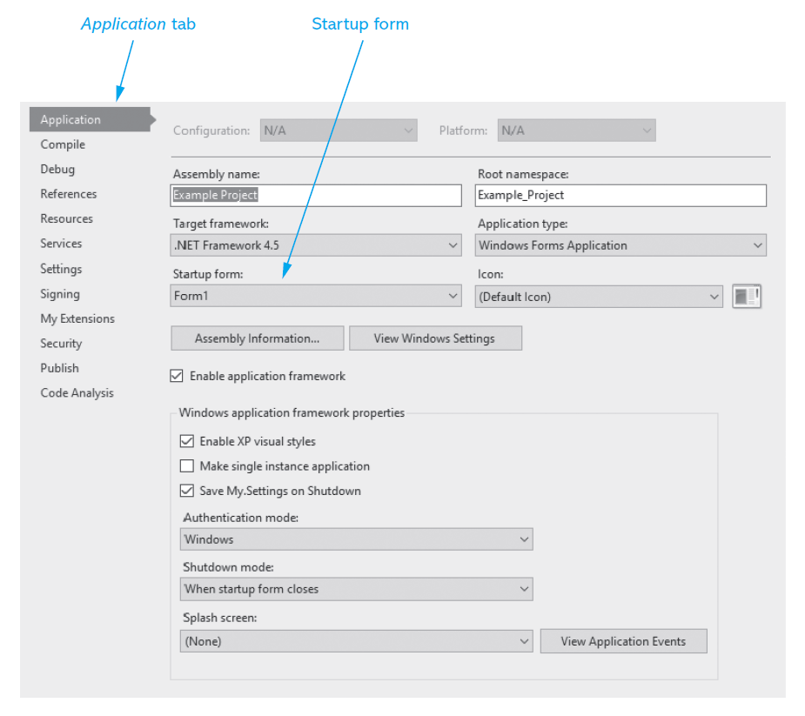
Designating the Startup Form
To make another form the startup form:
Right-click the project name in the Solution Explorer window
On the pop-up menu, click Properties, the properties page appears
Select the Application tab
Click the down arrow in the Startup Form drop-down list
Select a form from the list of available forms

Slide 13
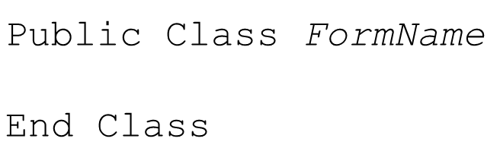
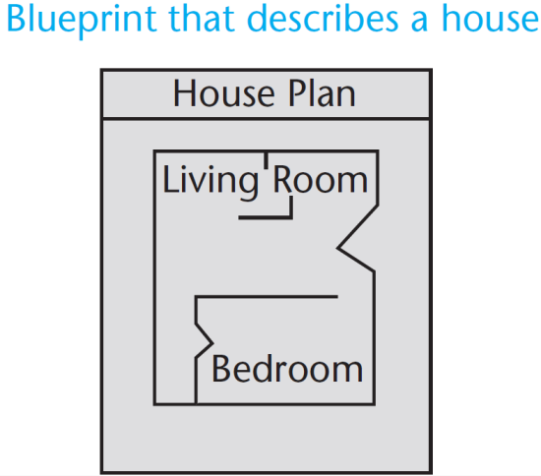
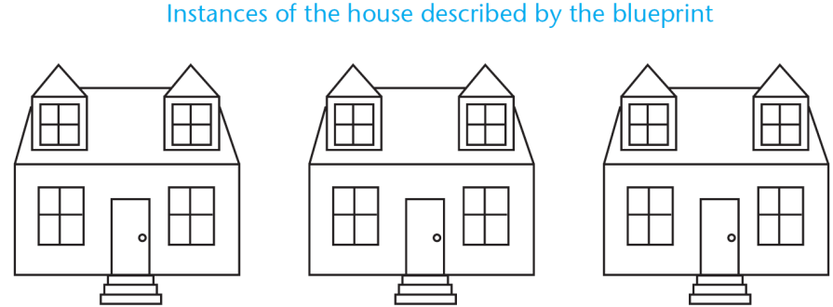
Creating an Instance of a Form
The form design is a class
It’s only a design or description of a form
Think of it like a blueprint
A blueprint is a detailed description of a house
A blueprint is not a house
The form design can be used to create instances of the form
Like building a house from the blueprint
To display a form, we must first create an instance of the form

Slide 14
Displaying a Form (1 of 2)
The first step is to create an instance of the form with the D i m statement
Here is the general format:
ObjectVariable is the name of an object variable that references an instance of the form
An object variable
Holds the memory address of an object
Allows you to work with the object
ClassName is the form’s class name

Slide 15
Displaying a Form (2 of 2)
The following statement creates an instance of the ErrorForm form in memory:
frm Error variable references the ErrorForm object
Statement does not cause the form to be displayed on the screen
To display the form on the screen:
Use the object variable to invoke one of the form’s methods
The prefix f r m is used to indicate that the variable references a form

Slide 16


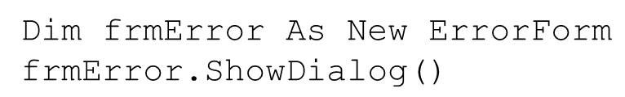
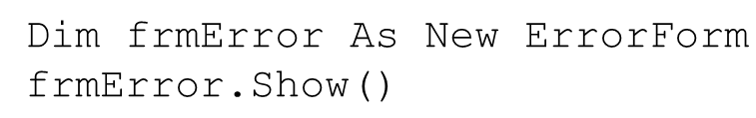
The ShowDialog and Show Methods
If a modal form is displayed:
No other form in the application can receive the focus until the form is closed
The ShowDialog method causes a form to be displayed as a modal form
Here is the general format:
If a modeless form is displayed:
The user is allowed to switch focus to another form while it is displayed
The Show method causes a form to be displayed as a modeless form
Here is the general format:
For example:
For example:

Slide 17
Closing a Form with the Close Method
The Close method closes a form and removes its visual part from memory
A form closes itself using the keyword Me
For example:
Causes the current instance of the form to call its own Close method, thus closing the form
The keyword Me in Visual Basic is a special variable that references the currently executing object

Slide 18
The Hide Method
The Hide method
Makes a form or control invisible
Does not remove it from memory
Similar to setting the Visible property to False
A form uses the Me keyword to call its own Hide method
For example:
To redisplay a hidden form:
Use the ShowDialog or Show methods
Tutorial 7-1 creates a simple application that has two forms

Slide 19
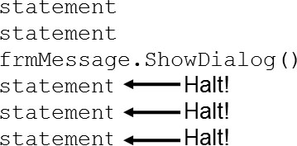
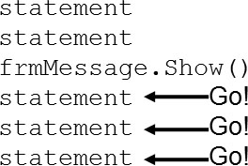
More on Modal and Modeless Forms
When a procedure calls the ShowDialog method
Display of a modal form causes execution of calling statements to halt until form is closed
When a procedure calls the Show method
Display of a modeless form allows execution to continue uninterrupted
Tutorial 7-2 demonstrates the difference between modal and modeless forms

Slide 20
The Load Event
The Load event is triggered just before the form is initially displayed
Any code needed to prepare the form prior to display should be in the Load event
If some controls should not be visible initially, set their Visible property in the Load event
Double-click on a blank area of the form to set up a Load event as shown below
Complete the template with the statements you wish the procedure to execute

Slide 21

The Activated Event
The Activated event occurs when the user switches to the form from another form or application
To create an Activated event handler, follow these steps:
Select the form in the Designer window
Select the Events button
in the Properties window toolbar
Double-click the Activated event name in the Properties window
After completing these steps, a code template for the event handler is created in the Code window

Slide 22
The FormClosing Event
The FormClosing event is triggered as the form is being closed, but before it has closed
The event can be used to ask the user if they really want the form closed
To create an FormClosing event handler, follow these steps:
Select the form in the Designer window
Select the Events button
in the Properties window toolbar
Double-click the FormClosing event name in the Properties window
After completing these steps, a code template for the event handler is created in the Code window

Slide 23
The FormClosed Event
The FormClosing event occurs after a form has closed
The event can be used to execute code immediately after a form has closed
To create an FormClosed event handler, follow these steps:
Select the form in the Designer window
Select the Events button
in the Properties window toolbar
Double-click the FormClosed event name in the Properties window
After completing these steps, a code template for the event handler is created in the Code window
You cannot prevent a form from closing with the FormClosed event handler. You must use the FormClosing event handler to prevent a form from closing.

Slide 24
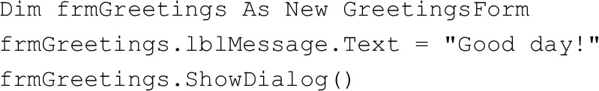
Accessing Controls on a Different Form
Once you have created an instance of a form, you can access controls on that form in code
The following code shows how you can
Create an instance of a form
Assign a value to the form’s label control’s Text property
Display the form in modal style
Tutorial 7-3 demonstrates accessing controls on a different form

Slide 25
Class-Level Variables in a Form
Class-level variables are declared Private by the Dim statement
Private variables are not accessible by code in other forms
Use the Public keyword to make a class-level variable available to methods outside the class
Explicitly declare class-level variables with the Private keyword to make your source code more self-documenting

Slide 26
Using Private and Public Procedures in a Form
Procedures, by default, are Public
They can be accessed by code outside their form
To make a procedure invisible outside its own form, declare it to be Private
You should always make the procedures in a form private
Unless you specifically want statements outside the form to execute the procedure

Slide 27
Using a Form in More Than One Project
After a form has been created and saved to a file, it may be used in other projects
Follow these steps to add an existing form to a project:
With the receiving project open in Visual Studio, click Project on the menu bar, and then click Add Existing Item
The Add Existing Item dialog box appears
Locate the form file that you want to add to the project, select it and click the Open button
A copy of the form is now added to the project

Slide 28
7.2 Modules

Slide 29
What is a Module?
A module is a Visual Basic file that contains only code
General purpose procedures, functions, and declarations of variables and constants
Can be accessed by all forms in the same project
No event handlers
Stored in files that end with the .v b extension
Appears in the Solution Explorer window along with entries for the project’s form files

Slide 30
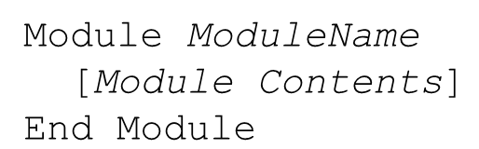
Module Names and Module Files
A module
begins with a Module statement
ends with an End Module statement
Here is the general format:
ModuleName is the name of the module
Can be any valid identifier that describes its purpose
Code is stored in a file that is named with the .v b extension
Normally, the name of the file is the same as the name of the module

Slide 31
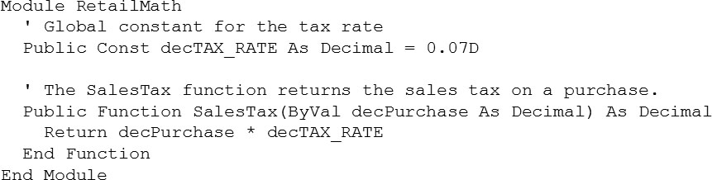
Module Example
The following code shows the contents of a module named RetailMath
Procedures, functions, and declarations can be declared as Private, which means that they can be accessed only by code in the same module

Slide 32
Adding a Module
Follow these steps to add a module to a project:
Click Project on the menu bar and then click Add Module. The Add New Item window appears
Change the default name that appears in the Name text box to the name you wish to give the new module file, and be sure to keep the .v b extension
Click the Add button
A new empty module will be added to your project
The module is displayed in the Code window
An entry for the module appears in the Solution Explorer window

Slide 33
Module-Level Variables
A module-level variable is a variable that is declared inside a module, but not inside a procedure or function
The same rules about the scope of class-level variables in a form apply to module-level variables in a module
Variables with module scope are declared with D i m or Private
Accessible to any function or procedure in the module
Not accessible to statements outside of the module
A global variable is declared with the Public keyword
Accessible to any statement in the application
Some programmers prefix global variables with g_
Tutorial 7-4 examines an application that uses a module

Slide 34
Using a Module in More Than One Project
It is possible to use more than one module in a project
Follow these steps to add an existing standard module to a project:
Click Project on the menu bar, and then click Add Existing Item. The Add Existing Item dialog box appears
Use the dialog box to locate the module file you want to add to the project. When you locate the file, select it and click the Open button
The module is now added to the project

Slide 35
7.3 Menus

Slide 36
Menu Systems
A menu system is a collection of commands organized in one or more drop-down menus
Commonly used when an application has several options for the user to choose from
The menu designer allows you to visually create a custom menu system
For any form in an application

Slide 37
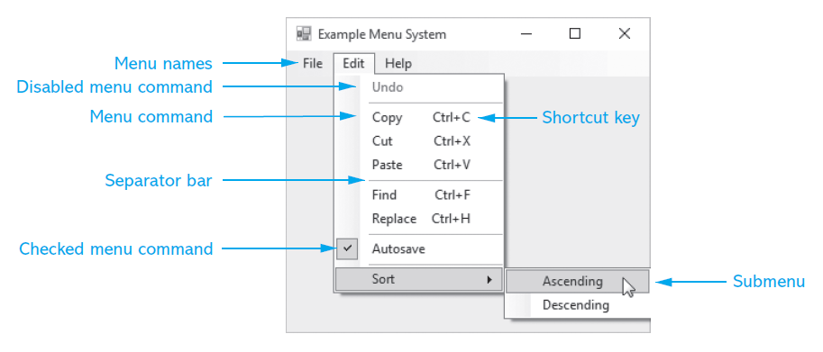
Components of a Menu System (1 of 2)
Each drop-down menu has a menu name
Each drop-down menu has a list of actions or menu commands that can be performed
Some commands may lead to a submenu

Slide 38
Components of a Menu System (2 of 2)
Actions may be performed using a key or key combination called a shortcut key
A checked menu command toggles between the checked (if on) and unchecked (if off) states
A separator bar helps group similar commands

Slide 39
MenuStrip Control
A MenuStrip control adds a menu to a form
Double-click on the MenuStrip icon in the Menus & Toolbars section of the Toolbox
The MenuStrip control is displayed in the component tray (bottom of Design window)
A MenuStrip can have many ToolStripMenuItem objects:
Each represents a single menu command
Name property - used by V B to identify it
Text property – text displayed to the user

Slide 40
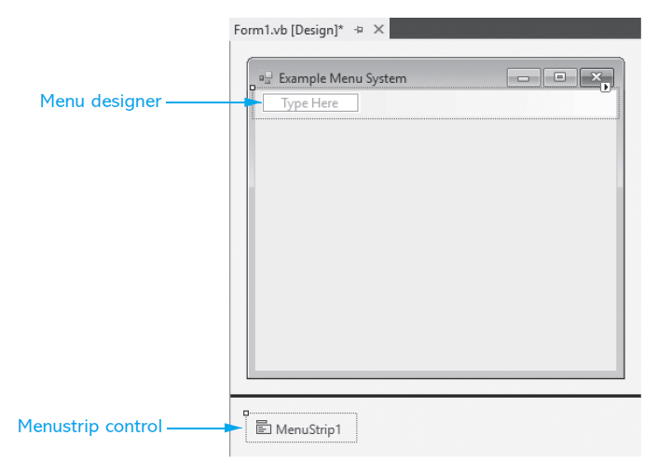
How to Use the Menu Designer
Select the MenuStrip Control
The menu designer appears on the form in the location that the menu system will appear

Slide 41
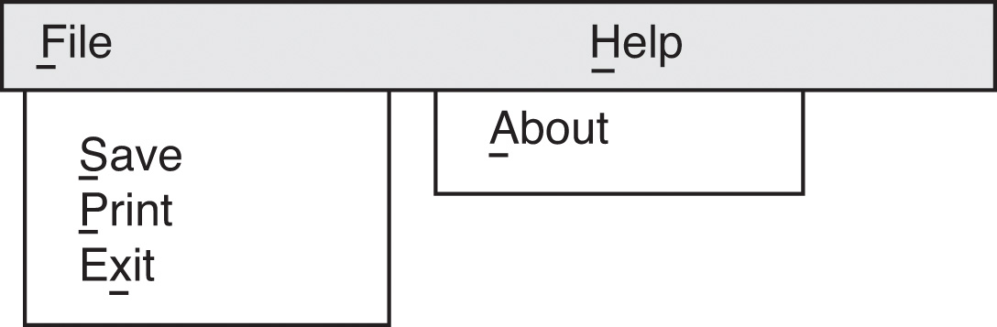
ToolStripMenuItem Object Names
It is recommended that you change the default value of the Name property so that it
Begins with the m n u prefix
Reflects the Text property and position in the menu hierarchy
m n u File
m n u FileSave
m n u FilePrint
m n u FileExit

Slide 42
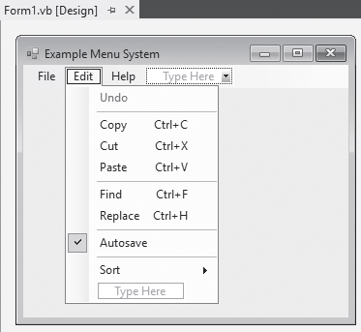
Shortcut Keys
Combination of keys that cause a menu command to execute
Ctrl + C to copy an item to the clipboard
Set with the ShortcutKeys property
Displayed only if the ShowShortcut property is set to True

Slide 43
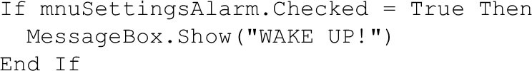
Checked Menu Items
Turns a feature on or off
For example, an alarm for a clock
To create a checked menu item:
Set CheckOnClick property to True
Set Checked property to True if feature should be on when the form is initially displayed

Slide 44
Disabled Menu Items
A menu item is grayed out (disabled) with the Enabled property, for example:
Paste option is initially disabled and only enabled after something is cut or copied
Code initially disables the Paste option
Following a cut or copy, Paste is enabled

Slide 45
Separator Bars
Right-click menu item, select Insert Separator
A separator bar will be inserted above the menu item
Or type a hyphen (-) as a menu item’s Text property

Slide 46
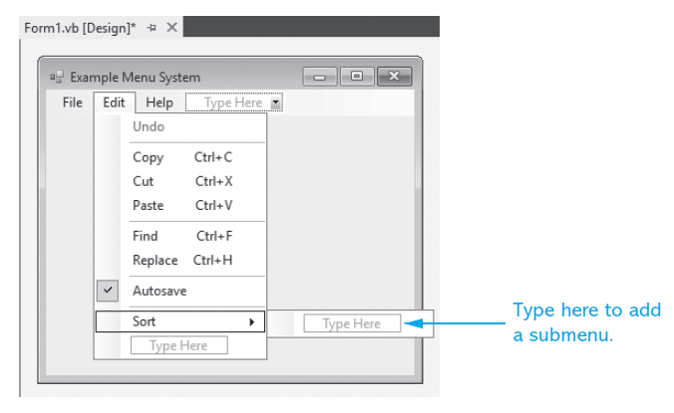
Submenus
When selecting a menu item in the menu designer, a Type Here box appears to the right
Begin a submenu by setting up this menu item
If a menu item has a submenu, a solid right-pointing arrow
will be shown

Slide 47
Inserting, Deleting, And Rearranging Menu Items
To insert a new menu item
Right-click an existing menu item
Select Insert then MenuItem from pop-up menu
A new menu item will be inserted above the existing menu item
To delete a menu item
Right-click on the item
Choose Delete from the pop-up menu
Or select the menu item and press the Delete key
To rearrange a menu item
Simply select the menu item in the menu designer and drag it to the desired location

Slide 48
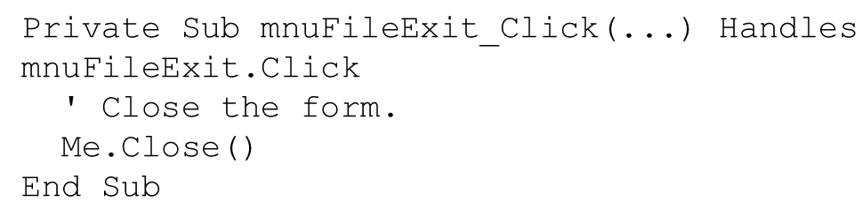
ToolStripMenuItem Click Event
Menus and submenus require no code
Commands must have a click event procedure
Double-click on the menu item
Event procedure created in the Code window
Programmer supplies the code to execute
Suppose a menu system has a File menu with an Exit command named m n u FileExit

Slide 49
Standard Menu Items
Most applications to have the following menu items
File as the leftmost item on the menu strip
Access key Alt + F
An Exit command on the File menu
Access key Alt + X
Shortcut key Alt + Q (optional)
Help as the rightmost item on the menu strip
Access key Alt + H
An About command on the Help menu
Access key Alt + A
Displays an About box
Tutorial 7-5 demonstrates how to build a simple menu system

Slide 50
Context Menus
A context menu, or pop-up menu, is displayed when the user right-clicks a form or control
To create a context menu
Double-click the ContextMenuStrip icon in the Toolbox window
A ContextMenuStrip control appears in the component tray
Change the ContextMenuStrip control’s default Name property
Add menu items with the menu designer
Create click event procedures for the menu items
Associate the context menu with a control
Set the control’s ContextMenuStrip property to the name of the ContextMenuStrip control

Slide 51
7.4 Focus on Problem Solving: Building the High Adventure Travel Agency Price Quote Application

Slide 52
Overview (2 of 2)
The High Adventure Travel Agency offers the following vacation packages for thrill-seeking customers
Scuba Adventure:
This package provides six days at a Caribbean resort with scuba lessons
The price for this package is $3,000 per person.
Sky Dive Adventure:
This package provides individual sky diving lessons during a six-day vacation at a luxury lodge
The price for this package is $2,500 per person
The travel agency gives a 10% discount for groups of five or more
You’ve been asked to create an application to calculate the charges for each package

Slide 53
Forms and Modules
The MainForm form
Is the application’s startup form
Provides a menu that allows the user to select one of the vacation packages
The ScubaForm form
Calculates the price of a scuba adventure travel package
The SkyDiveForm form
Calculates the price of a sky dive adventure travel package
The PriceC a l c Module module
Contain global constants and a function that both the ScubaForm and SkyDiveForm forms will use to calculate discounts

Slide 54
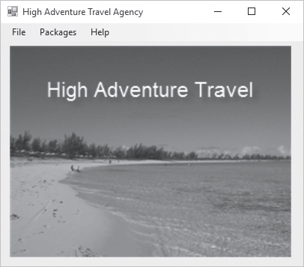
The MainForm Form

Slide 55
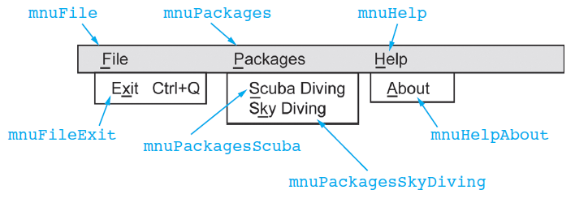
The MainForm Menu System

Slide 56
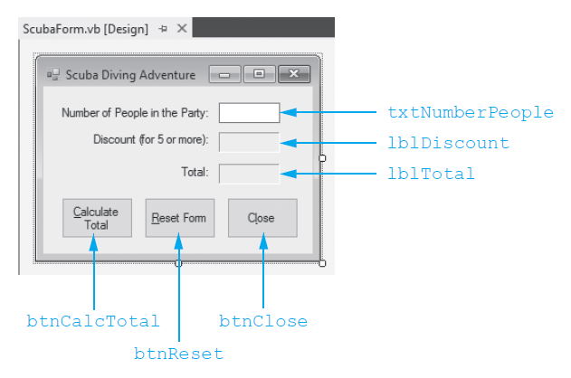
The ScubaForm Form

Slide 57
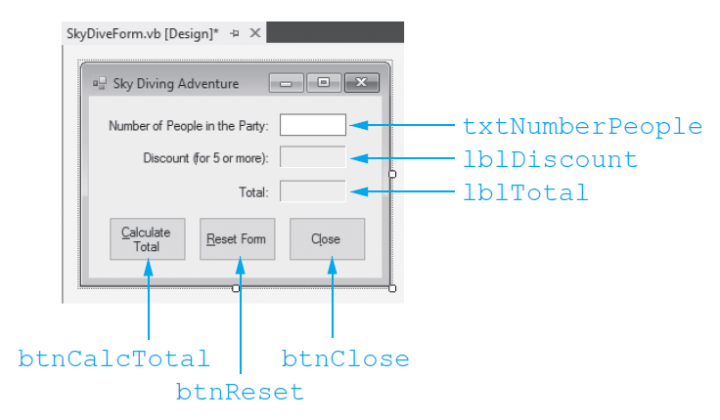
The SkyDiveForm Form

Slide 58
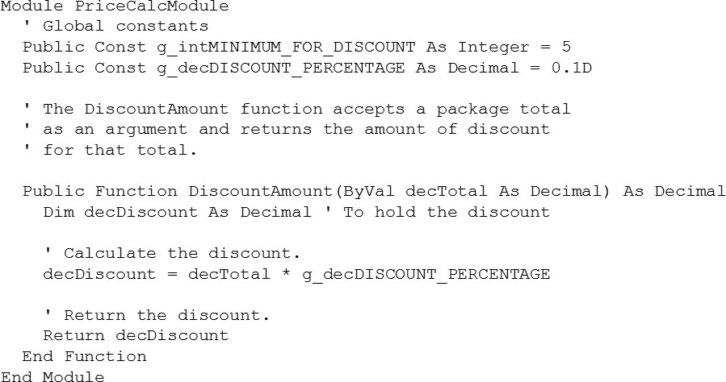
The PriceC a l c Module Module

Slide 59

Copyright

